Slide 1
Building Responsive Web Applications

Slide 2
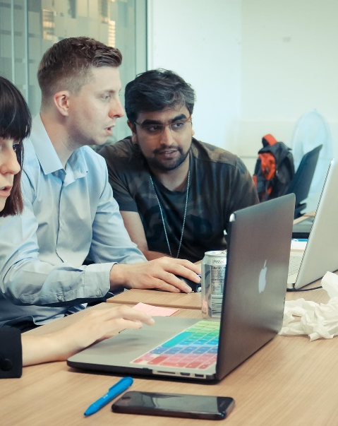
Learning Check
Features of HTML and HTML5
CSS and CSS3
HTML5 APIs
Responsive apps
Progressive Web Applications (PWAs)
Grid and Flex
JavaScript
Ajax

Slide 3
Semantic controls
Tags like <div> , <p> , <span> are not semantic elements because we don't know their content type or purpose
Tags like <form>, <table>, and <article> define their content by their name.
<header> Subject matter
<nav> for navigation
<article> The main article
<aside> side tag for extra info/ads
<footer>
Other semantic elements are:
<details> <figcaption> <figure>
<main> <section> <time>
<mark> <summary>
<header>
<nav>
<section>
<aside>
<article>
<footer>

Slide 4
CSS – media queries
Introduced in CSS3 to discover the capability of the device on the client side.
Can be used to check many things, such as: width and height of the viewport, etc.
Enables you to create Responsive web design.
Can write different CSS code depending on the client's device
<style>
@media screen and (max-width:1000px) {
body {
background-color: lightsteelblue;
}
h1 {
font-size: 20pt;
}
}
Demo

Slide 5
CSS3 - Animation
Demo
Keyframes
Rotation and Translation
Rotation in Z direction
Demo
Demo

Slide 6
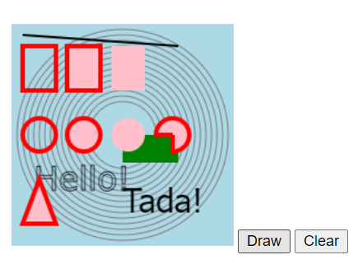
Canvas
HTML5 Canvas enables you to dynamically create 2D shapes, lines and bitmap images using JavaScript code
Through WebGL it allows 3D shapes and images to be displayed
Demo

Slide 7
SVG
SVG stands for Scalable Vector Graphics
Used for describing 2D-graphics and graphical applications in XML which is then rendered by an SVG viewer.
SVG is mostly useful for vector type diagrams like Pie charts, Two-dimensional graphs in an X,Y coordinate system
Can zoom without pixilation
Embedding SVG on a web page
<svg height="200" width="500">
<ellipse cx="400" cy="70" rx="85" ry="55" fill="blue" />
<text fill="#ffffff" font-size="25" font-family="Verdana" x="380" y="86">QA</text>
Sorry, your browser does not support inline SVG.
</svg>
Demo

Slide 8
SVG filters
SVG filters can be defined within the <defs> section of the SVG XML
Can be reused by other HTML elements
<svg viewBox="0 0 150 100">
<defs>
<filter id="blur" x="-20%" y="-20%" width="140%" height="150%">
<feGaussianBlur in="SourceGraphic" stdDeviation="3" />
</filter>
</defs>
<rect x="0" y="0" width="150" height="100" stroke="gray" stroke-width="25" fill="white" />
<circle cx="50" cy="50" r="40" stroke="blue" stroke-width="10" fill="cyan" />
<circle id="live" cx="100" cy="50" r="25" stroke="red" stroke-width="10" fill="pink" filter="url(#blur)" />
</svg>
<h3>Applying filter to HTML element</h3>
<img id="image1" src="team.jpg" style="filter: url(#blur);"/>

Slide 9
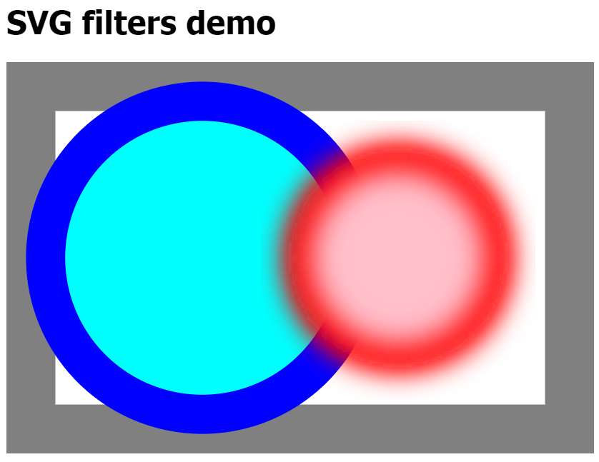
DEMO of SVG filter
Demo

Slide 10
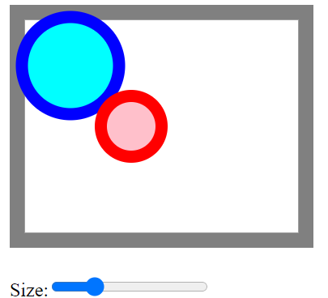
JavaScript and SVG
Demo

Slide 11
Using CSS animation with SVG
Demo

Slide 12
HTML APIs - Audio
<audio src="https://qa.com/meetings/feb.mp4"
controls autoplay loop>
<source src="https://qa.com/meetings/feb.wav">
<p>Sorry, your browser cannot play mp4 or wav files</p>
</audio>
Demo

Slide 13
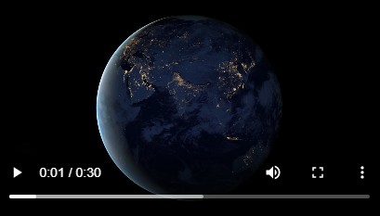
HTML APIs – Playing Video
<!DOCTYPE html>
<html>
<body>
<button onclick="playPause()" controls>Play/Pause</button>
<video id="video1" width="420" controls>
<source src="earth.mp4" type="video/mp4">
<source src="earth.ogg" type="video/ogg">
Your browser does not support HTML video.
</video>
<script>
var myVideo = document.getElementById("video1");
function playPause() {
if (myVideo.paused)
myVideo.play();
else
myVideo.pause();
}
</script>
</body>
</html>

Slide 14
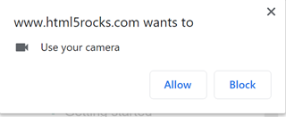

HTML5 APIs - Capturing Video – getUserMedia()
<video autoplay id="video1"></video>
<script>
var video = document.querySelector("#video1");
if (navigator.mediaDevices.getUserMedia)
capture();
function capture() {
const constraints = { video: true };
navigator.mediaDevices.getUserMedia(constraints)
.then(function (stream) {
video.srcObject = stream;
})
.catch(function (err) { alert(err); });
}
</script>
Demo
https://www.html5rocks.com/en/tutorials/getusermedia/intro/
Notes:
And here’s the code.
To use the webcam or microphone, we need to request permission. The parameter to getUserMedia() is an object specifying the details and requirements for each type of media you want to access. For example, if you want to access the webcam, the parameter should be {video: true}. To use both the microphone and camera, pass {video: true, audio: true}:

Slide 15
HTML APIs – File API
Get file content from client
<body>
<input id="myfile" type='file' accept='text/text'>
<button onclick="showFile()">Show file</button>
</body>
<script>
function showFile() {
var fileUpload = document.getElementById("myfile");
// choose file/s from the client side
var file = fileUpload.files[0];
var reader = new FileReader();
reader.readAsText(file, "UTF-8"); // IS asynchronous
reader.onload = function () {
alert(reader.result);
};
}
</script>
Demo

Slide 16
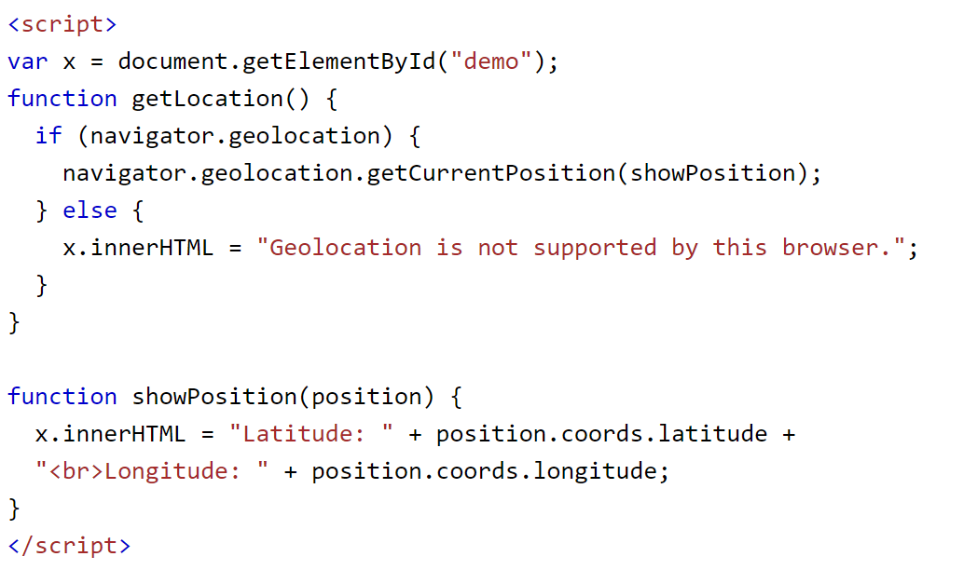
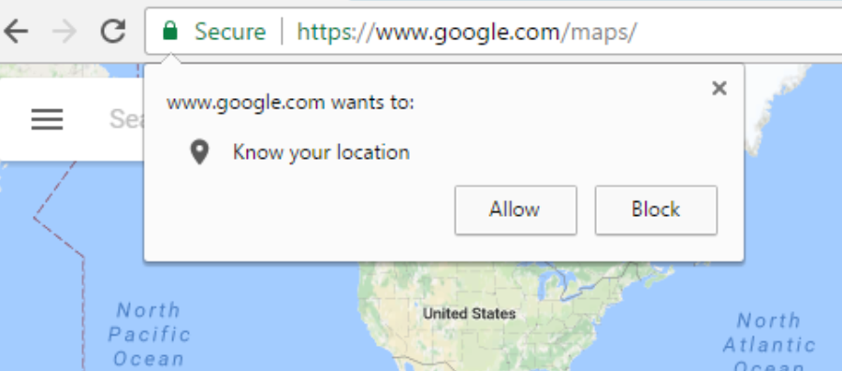
Geo Location
For what kind of applications might we want to request a user’s location?
Demo

Slide 17
Flexbox layout
Used for displaying items in a container, in a very flexible way
Easy to make work well on both large and small screens (responsive)
Can be used anywhere, including embedded in other containers or grids
Different to a CSS grid, because number of rows and columns changes dynamically depending on items within container and other constraints
See: https://flexboxfroggy.com/ for a fun, interactive game to learn flexbox

Slide 18
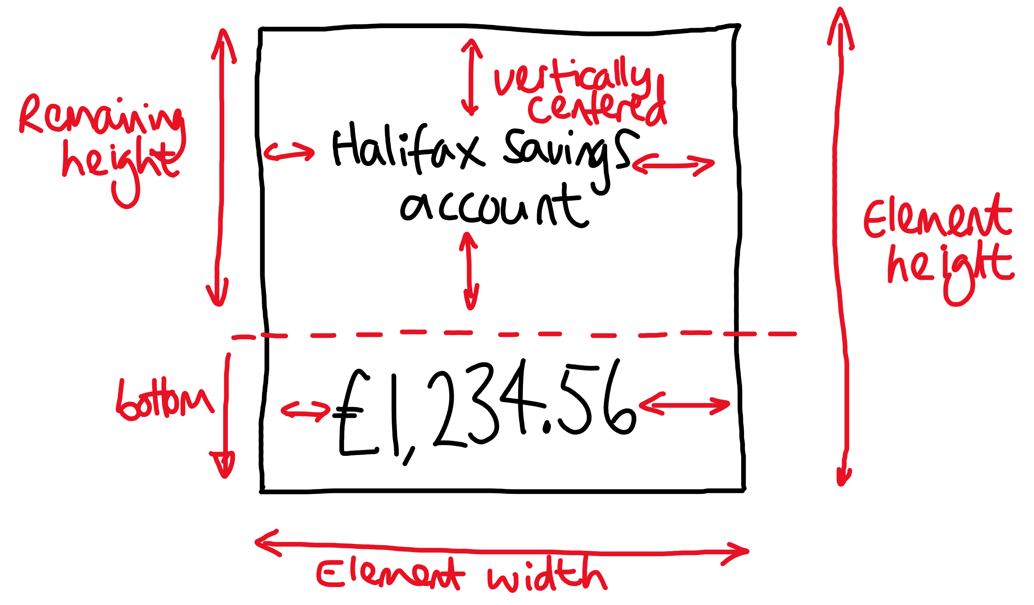
Example - account info display

Slide 19
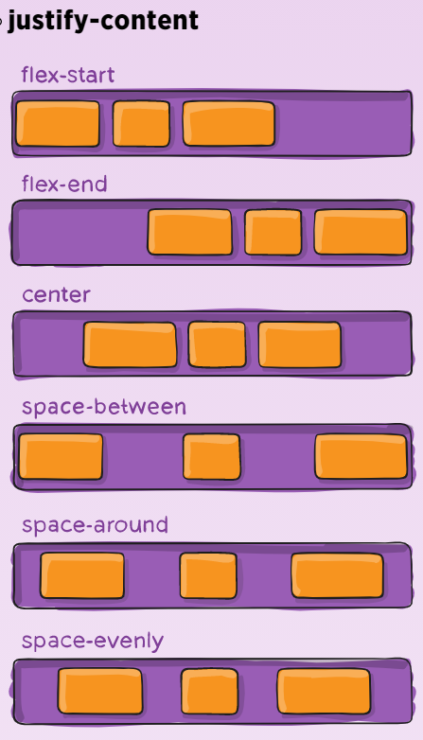
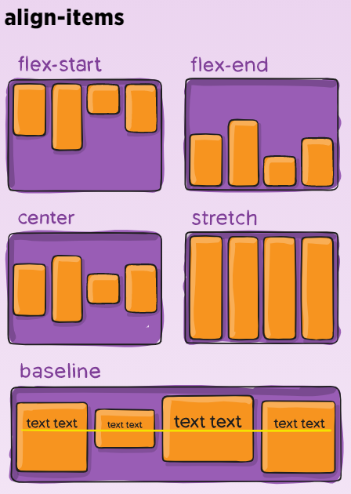
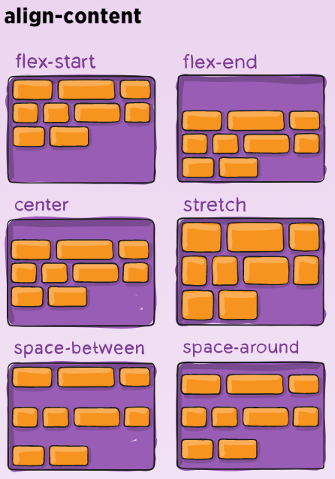
Justify / align property values
Demo
from https://css-tricks.com/snippets/css/a-guide-to-flexbox/

Slide 20
Grid
Positions blocks of content on the screen using a grid format
Can control the page layout - or used within individual elements
Can have a pre-defined set of rows and columns, or auto-extend with new rows as needed
Content can be placed into the grid automatically, or by using row/column coordinates, or by using a template of named areas
The width & height of rows can change depending on space available
Media queries can change the grid layout

Slide 21
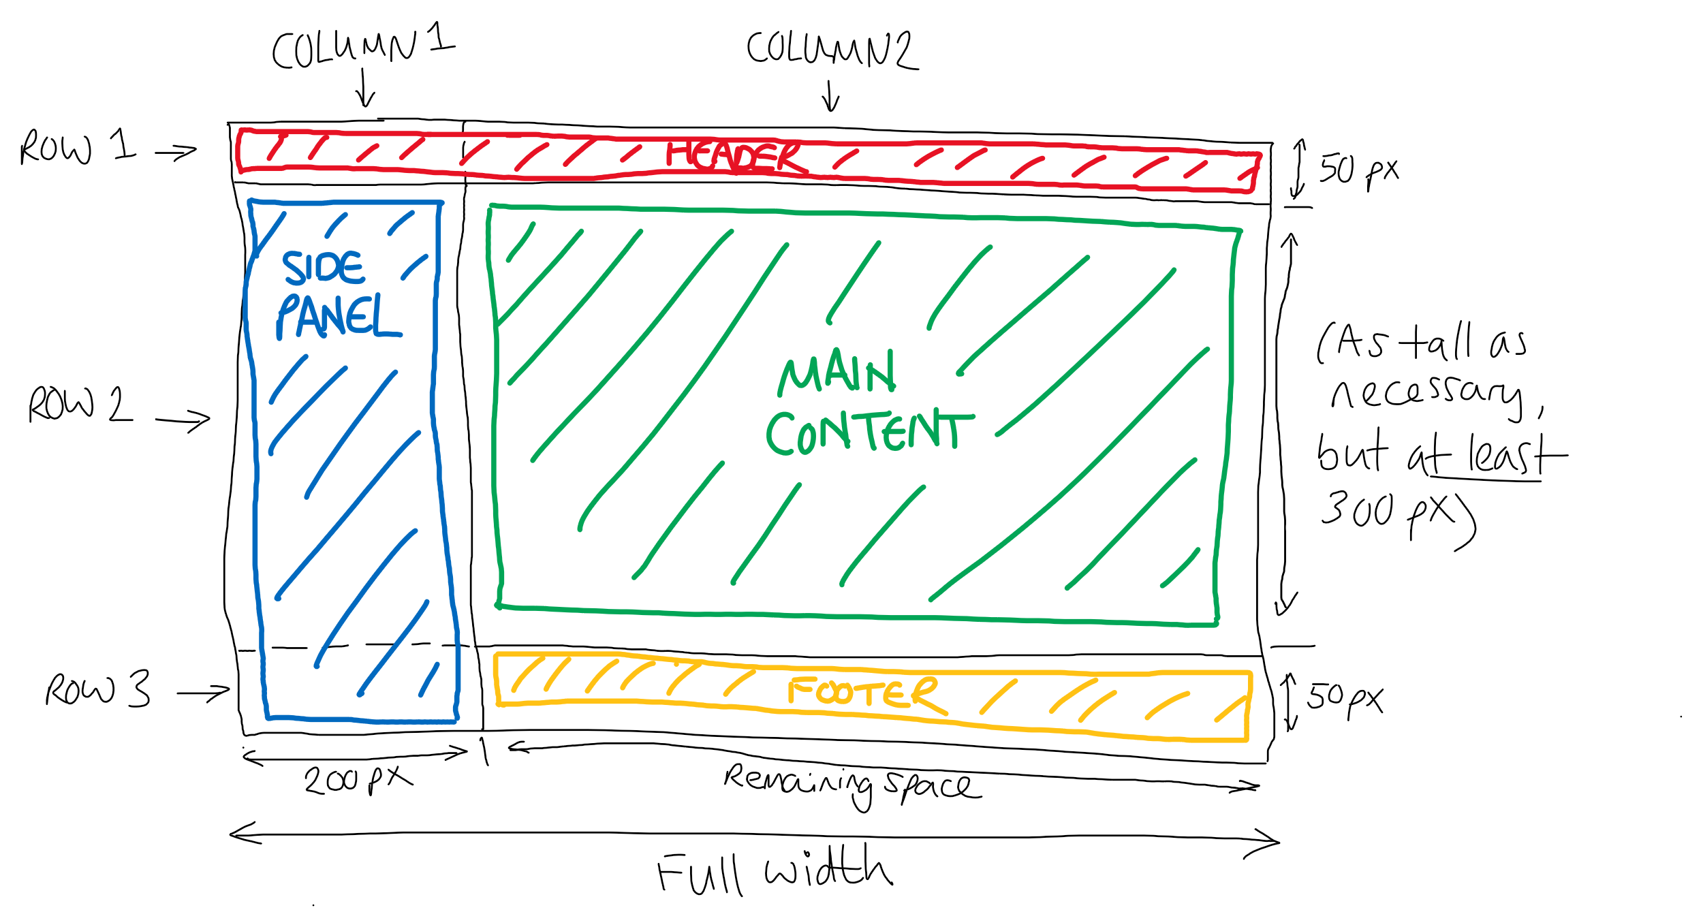
Example layout (desktop)
Demo
Notes:
Discuss row / column numbers verses track numbers (1/3 notation makes more sense then!)

Slide 22
HTML5 APIs - State
localStorage
Data is saved across browser sessions.
has no expiration time
sessionStorage
gets cleared when the page session ends
Do not store sensitive data on a client's machines
Demo

Slide 23
JavaScript – Ajax
What is a Promise?
Ajax using Fetch and Promise to get / update data
<script>
fetch('https://jsonplaceholder.typicode.com/todos')
.then(res => {
return res.json();
}).then(data => {
display(data);
});
function display(data) {
data.forEach(cus => {
document.write(`<div>${todo.id}: ${todo.title}, ${todo.completed}</div>`);
});
}
</script>
Demo

Slide 24
JavaScript – Reading Json data
<script>
let dataText = `
{
"menu": {
"id": "file",
"value": "File",
"popup": {
"menuitem": [
{ "value": "New", "onclick": "CreateNewDoc()" },
{ "value": "Open", "onclick": "OpenDoc()" },
{ "value": "Close", "onclick": "CloseDoc()" }
]
}
}
}`;
let data = JSON.parse(dataText);
document.write(data.menu.value); // prints File
document.write("<br />");
document.write(data.menu.popup.menuitem[1].value); // prints Open
</script>
Demo

Slide 25
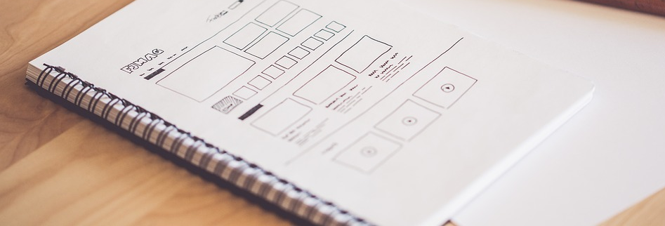
PRACTICE ACTIVITY
Next, we will practise developing User Interface designs as teams or by yourself
Create a site to include as many features as mentioned in this course

Slide 26
Lab
Next few pages offer suggestions for web apps which you can create individually or as groups.
Please pick a site that interests you.
You may combine some of these sites together or do something of your own.
Try to implement some of the HTML5 features discussed in this slideshow.

Slide 27
A few ideas
Portfolio web site tell people what your interests are and what activities you do.
Create a site about your company
An About page.
Display your products.
Let user select a product to see more information
Create a website about your favourite sporting team
Its history,
Main managers and team members, present and the past (with pictures).
Create a music video or audio site.
Categorise songs by type.
Change the src attribute of an <audio> tag to play the song.

Slide 28
A few ideas…
Create a site about the courses you have attended When a user selects a course, the site displays Start date what you learned, what you found useful, what was less useful and why, who was the trainer and anything else that you remember.
Create a survey site You can make the questions static or (if you have time) read them from an array and then create the questions dynamically.
Create a page where people can leave comments about the question of the day.
Make a website that offers a new quote from a famous person. Users can choose the type of quote they wish to see.

